Slide 1


IoT-Based Renewable Energy Monitoring System for Microgrid
EDI (Engineering Design and Innovation) Vishwakarma Institute of Technology (VIT), Pune.
Under the Guidance of Mr. Mukund Nalawade
Presented by: Shantanu Sasane (Roll No. 54) Harshal Shinde (Roll No. 59) Rahul Patil (Roll No. 64) Ahmed Shaikh (Roll No. 66) Shantanu Shewale (Roll No. 67) Vinit Takate (Roll No. 68)

Slide 2

Introduction & Problem Statement
What is a Microgrid?
Importance of Solar Integration
Need for Real-Time Monitoring
A localized group of electricity sources and loads that typically operates connected to a conventional synchronous grid, but can also disconnect and operate autonomously.
Integrating solar energy into microgrids enhances sustainability, reduces reliance on fossil fuels, and provides clean power generation.
Effective microgrid management requires immediate data on energy production and consumption to optimize performance and prevent inefficiencies.
Traditional Grid Challenges
Conventional grids often suffer from unmonitored consumption, leading to inefficiencies, increased energy wastage, and difficulty in identifying peak demand.

Slide 3
System Architecture & Block Diagram
Our system integrates several key components to create a robust and efficient monitoring solution for renewable energy microgrids.
1
2
ESP32 Microcontroller
Renewable Input
The brain of the system, enabling IoT connectivity and data processing.
A 6V 2.5W solar panel serves as the primary energy source.
3
4
Energy Storage
Charging Module
A 4-cell Li-Ion battery pack ensures continuous power supply.
TP4056 safely manages battery charging and discharge cycles.
5
6
Sensing Units
Power Regulation
Voltage and current sensors provide critical real-time measurements.
A 7805 regulator ensures a stable 5V output for sensitive components.

Slide 4
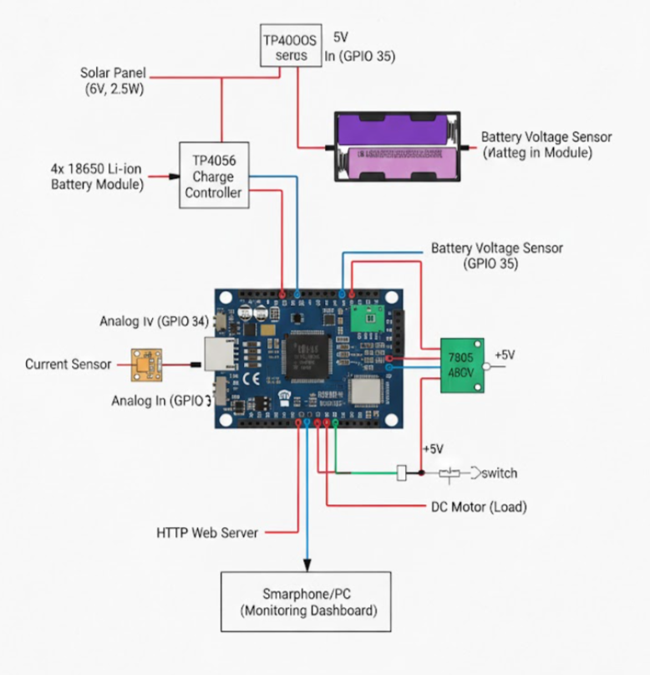
Block Diagram

Slide 5
Hardware Components & Technical Specifications
ESP32
IoT & WiFi monitoring
ADC Pin Configuration
Solar Panel 6V 2.5W
Renewable Input
ADC pins 34, 35, and 32 are utilized to read analog signals from various sensors, providing crucial data for system monitoring.
1
Li-ion cells
Energy Storage
TP4056
Safe Charging
ACS712 Current Sensor
Current measurement
Power Flow Diagram
Solar Panel → Regulator (7805) → Battery (Li-Ion) → Load (DC Motor) → Sensing (ACS712, Voltage Dividers) → Dashboard (Wi-Fi).
2
Voltage Divider Sensor
Panel & battery measurement
7805 regulator
Stable 5V power
DC Motor
Load demonstration

Slide 6
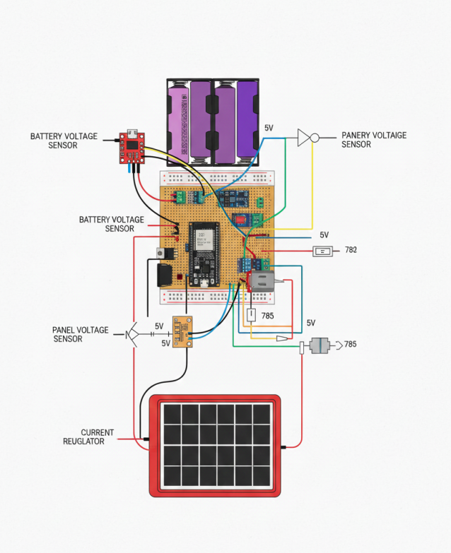
Circuit Diagram

Slide 7
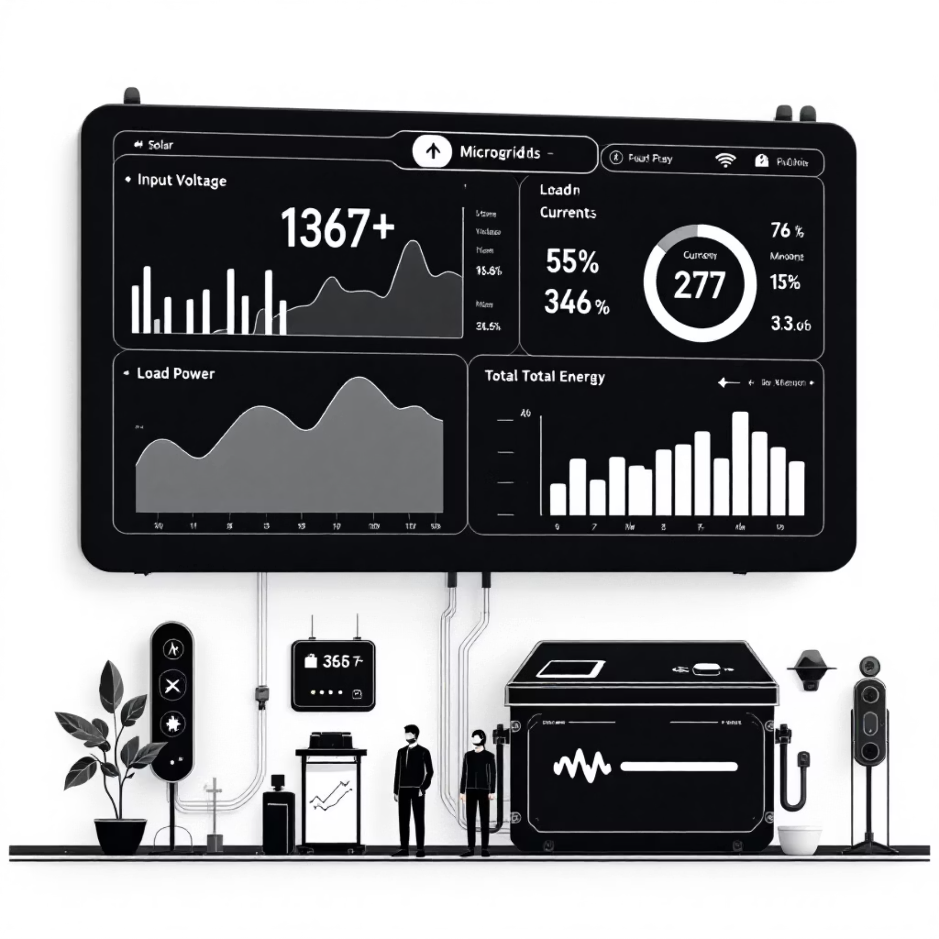
Software & IoT Dashboard
ESP32 Program Block
Custom firmware on the ESP32 handles sensor data acquisition and WiFi communication.
WiFi Server
An embedded web server (port 80) hosts the monitoring dashboard.
JSON Data API
The /data endpoint provides real-time sensor readings in JSON format.
Monitoring Dashboard
A web-based interface displays key parameters instantly.
Data Reset
The /reset function allows for clearing accumulated energy data.

Slide 8
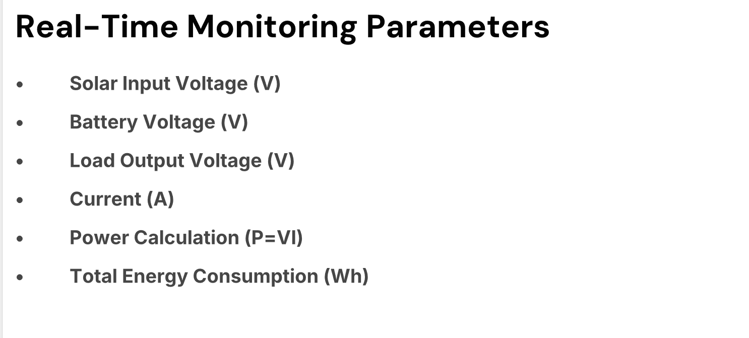
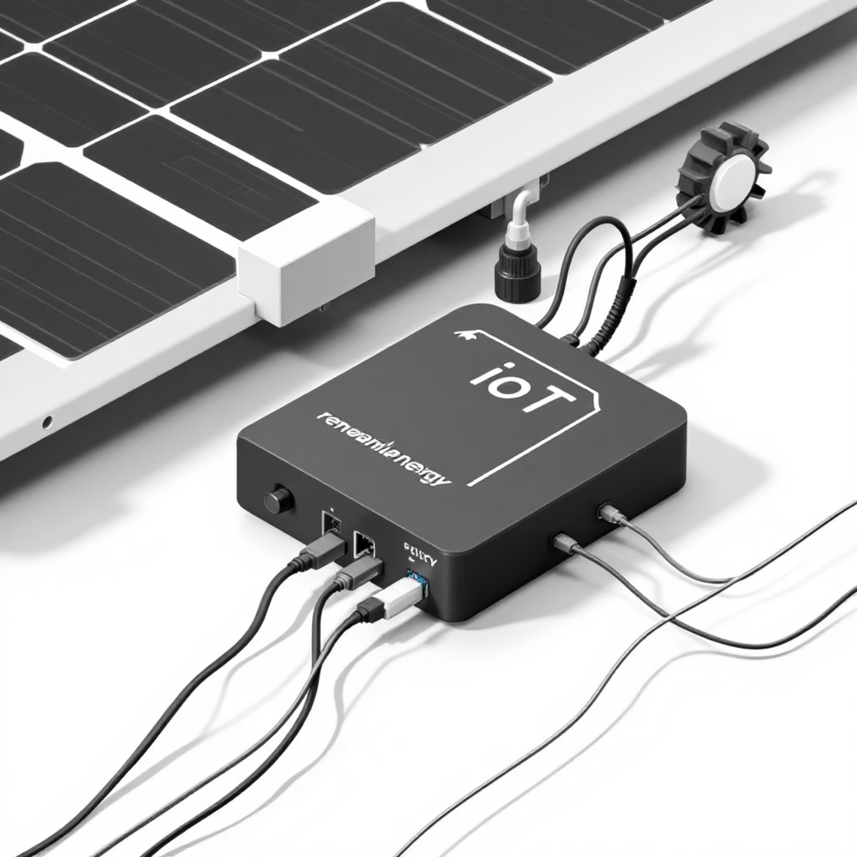

Slide 9
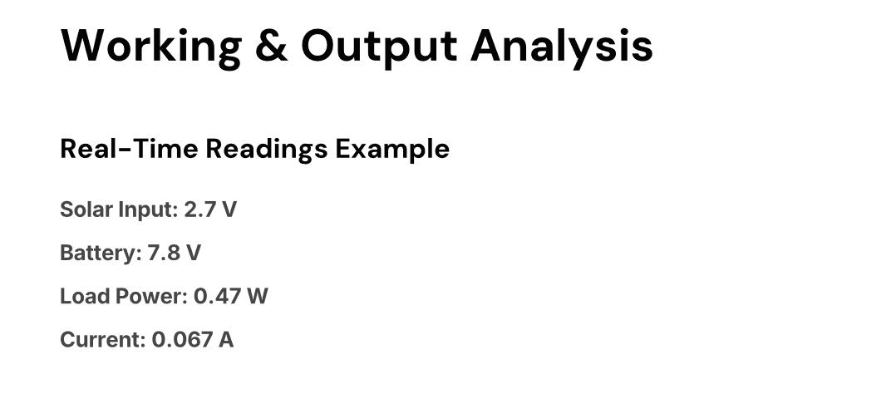
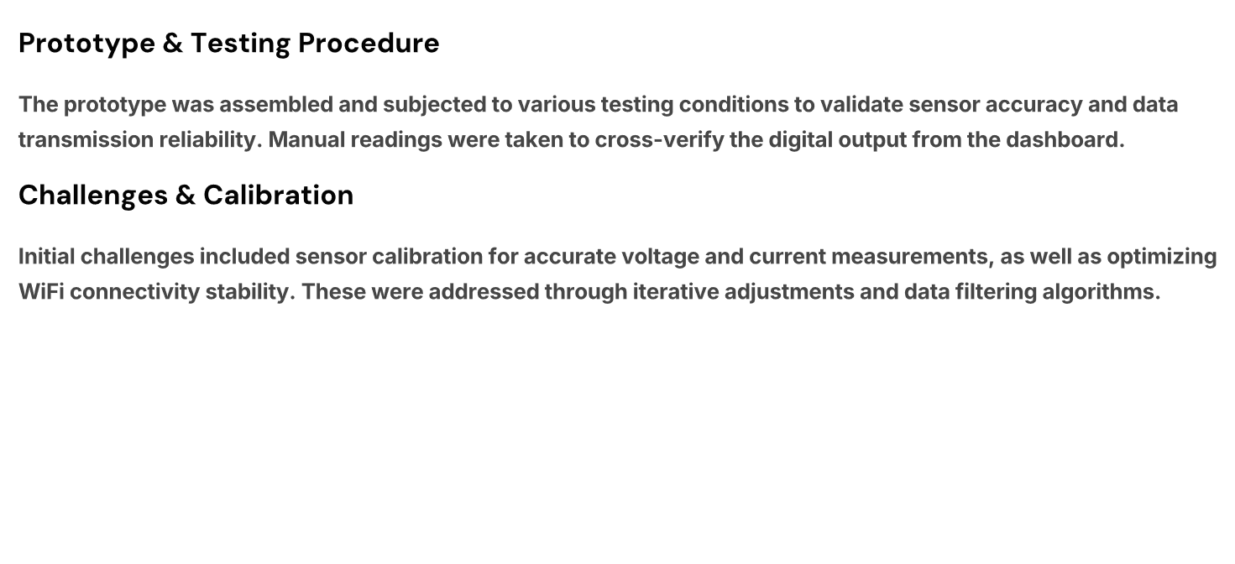

Slide 10
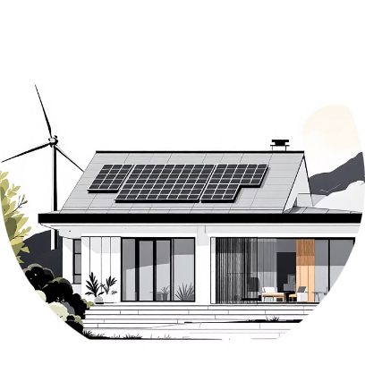
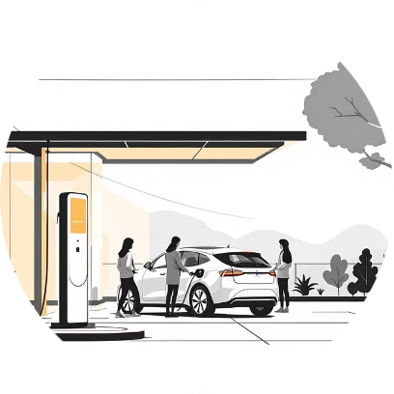
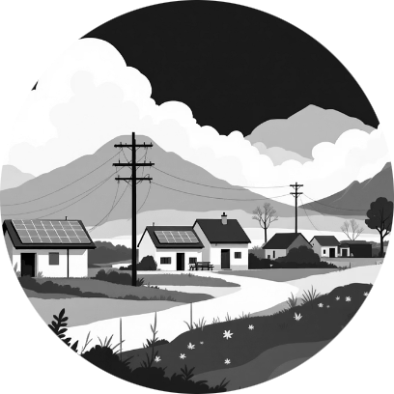
Applications & Future Scope
Smart Microgrids & Homes
Smart EV Charging
Rural Electrification
Integrating IoT monitoring with EV charging infrastructure allows for dynamic load balancing and efficient use of renewable energy sources.
The low-cost, real-time monitoring solution can significantly enhance the reliability and efficiency of off-grid rural electrification projects.
Our system can be scaled for advanced energy management in urban microgrids and individual smart homes, optimizing consumption and generation.
Real-time Analytics
AI-driven Optimization
Enabling predictive load forecasting and optimized energy distribution.
Future integration with AI for smart energy scheduling and renewable resource management.
Battery Health Monitoring
Solar Forecasting
Advanced diagnostics for extending battery lifespan and performance.
Utilizing weather data to predict solar generation for proactive grid management.

Slide 11

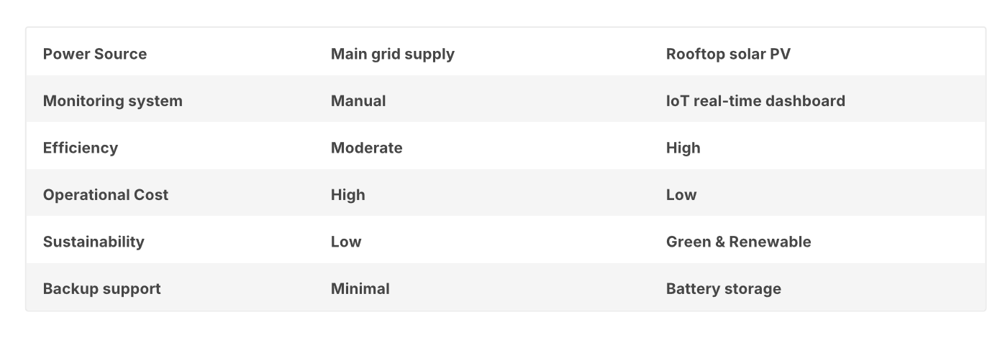
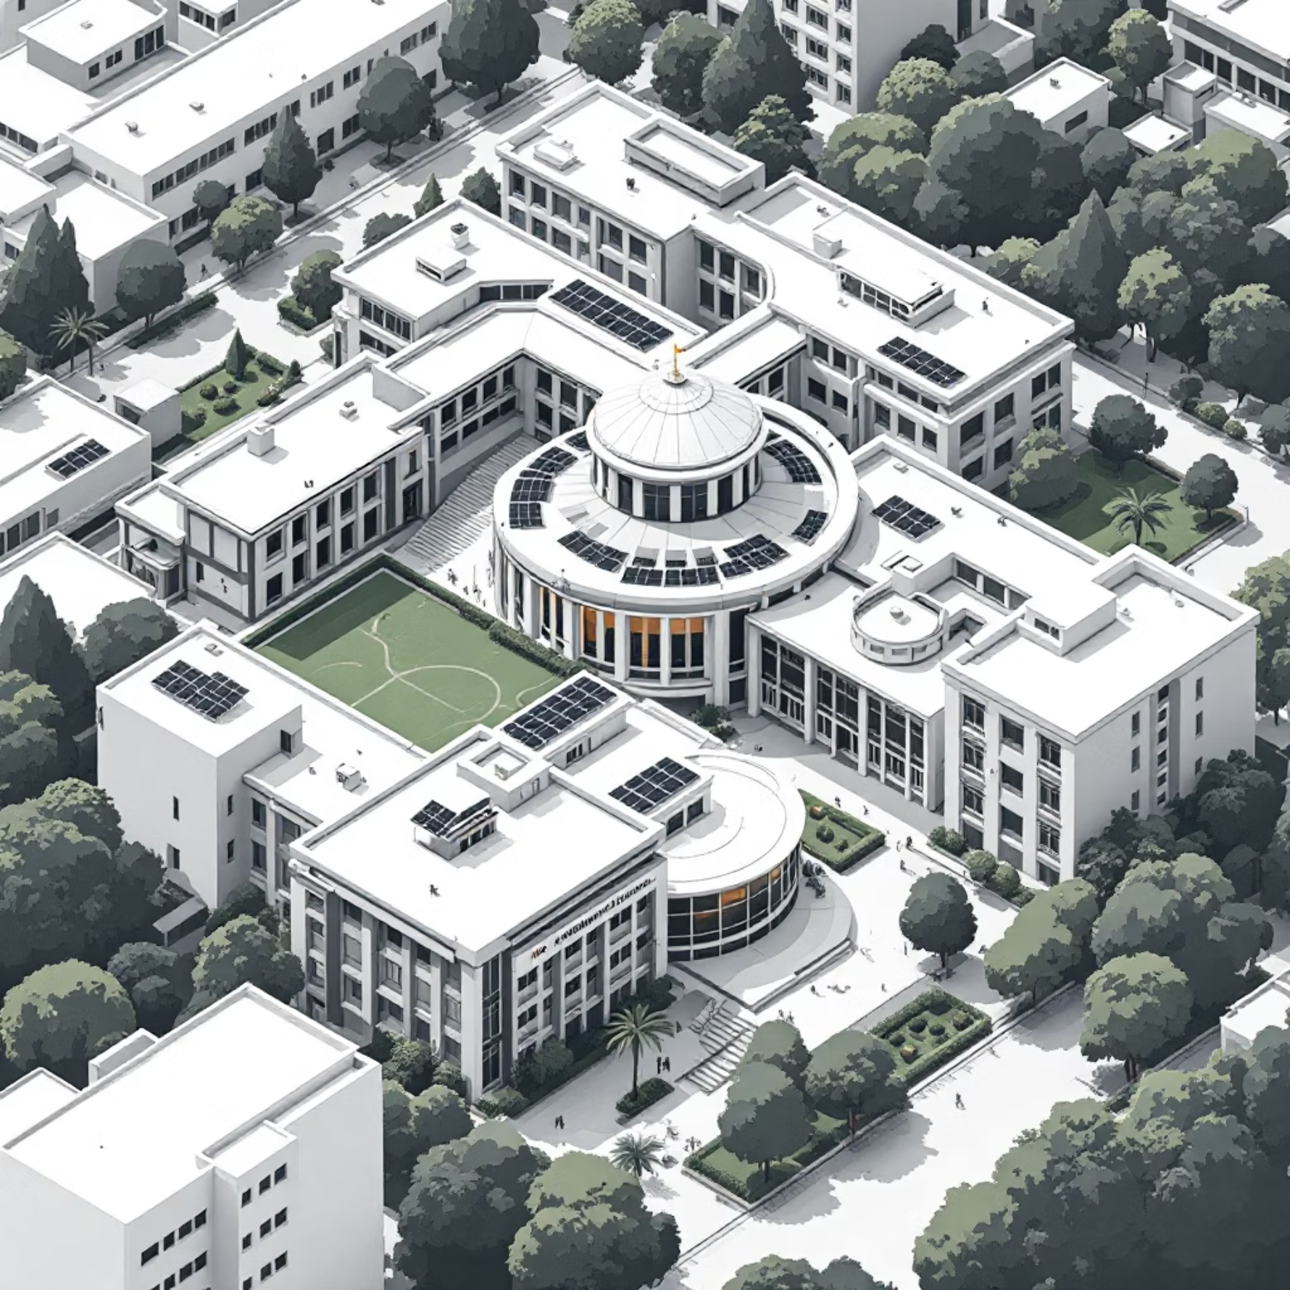
Power Source
Main grid supply
Rooftop solar PV
Monitoring system
Manual
IoT real-time dashboard
Efficiency
Moderate
High
Operational Cost
High
Low
Sustainability
Low
Green & Renewable
Backup support
Battery storage
Conclusion
Successful Prototype: The IoT-based prototype effectively monitors renewable power flow in real-time, validating our system's core functionality.
Reduced Grid Load: Integrating solar with an IoT system offers a scalable solution for campuses to significantly reduce reliance on the main grid.
Smart Microgrid Ready: Our platform is designed for scalability, laying the groundwork for advanced Smart Microgrid deployments in various settings.

Slide 12
Key Advantages & Real-World Impact
Our IoT-based renewable energy monitoring system offers significant benefits over traditional approaches, transforming how microgrids operate and manage energy.
Optimized Energy Management
Enhanced Grid Reliability
Real-time data from our system allows for immediate adjustments in energy production and consumption, leading to greater efficiency and reduced waste, as demonstrated in the VIT Campus case study.
By constantly monitoring critical parameters, our solution helps identify and mitigate potential issues before they impact the microgrid, ensuring a stable and continuous power supply.
Significant Cost Savings
Scalable & Sustainable Solutions
Minimizing energy losses, optimizing resource allocation, and enabling predictive maintenance directly translate into lower operational costs and a faster return on investment.
The adaptable design supports deployment across various scales, from individual smart homes to large university campuses, fostering greater reliance on green, renewable energy sources.

